Slide 1

Technological revolution
Presented By:-
Abdul Rasheed
21PWCSE2063

Slide 2
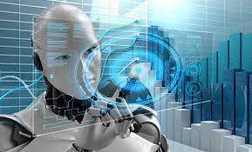
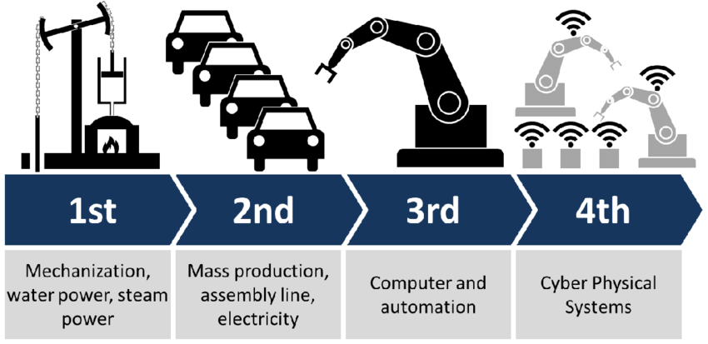
Introduction:
A technological revolution is a period in which one or more technologies is replaced by another.
It may involve material or ideological changes caused by the introduction of a device or system, its potential are education finance and research methodology.
Four technological revolution eras have been passed so far.

Slide 3
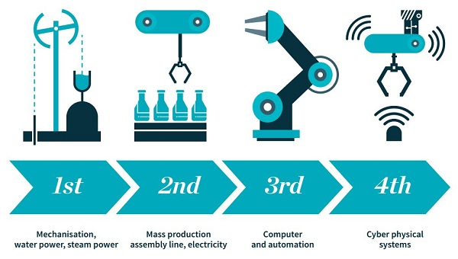
First Technological revolution:
It started at the end of 18th century to the beginning of 19th
The biggest changes came in the industries in the form of mechanism.i.e water power, steam power.
Notes:
The changes refered to mechanism.

Slide 4
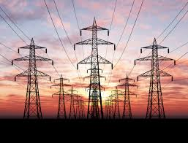
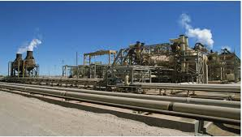
Second technological revolution:
It started at the end of 19th century with massive technological advancement in industries that helped the emergence of new sources of energy like electricity, gas and oil.
There were the development of steel demand, chemical synthesis and methods of communincation. i.e telephone and telegraph.

Slide 5
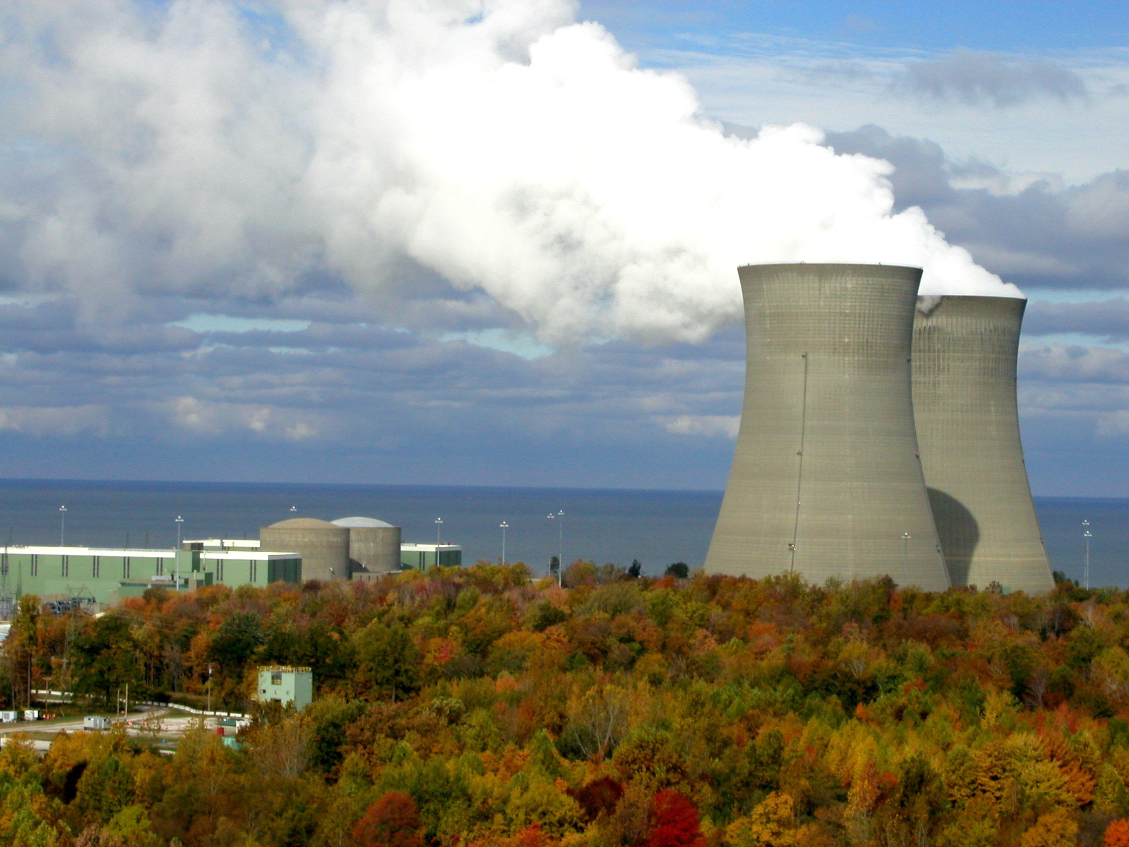
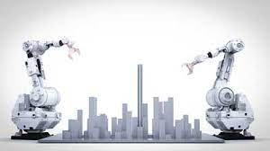
Third technological revolution:
In the second half of the 20th century, we see the emergence of yet another source of energy( Nuclear Energy).
Third revolution bought rise of electronics, telecommunications and, computers.
Programmable Logic Controllers(PLCs) and Robots, also rise in this era of revolution.

Slide 6
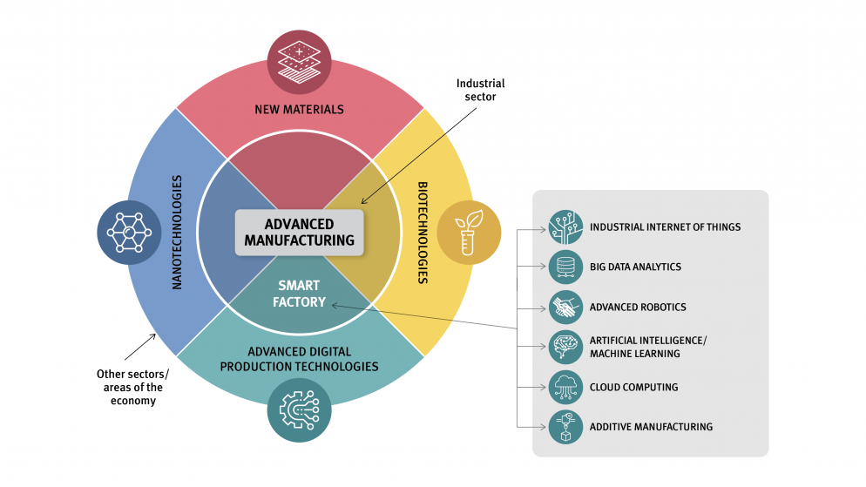
Fourth technological revolution:
The fourth technological revolution is powered by suite of core technologies that has been advancing for decades at an exponential rate. For instance Additive Manufacturing, Advanced Robotics, AL and Machine Learning, The internet of Things(IoT), and Virtual Reality.

Slide 7
Impact on world:
Every major technological revolution has had a profound impact on humankind’s production patterns and lifestyle.
The use of IT enables people to break their fast reliance on conventional means of transportation and communication and expands their scope of development and contacts.
It increases our productivity make the service we need more accessible and overall make our life easier

Slide 8
Thank You

